Slide 1
Machine Learning for Mechanical Systems Professor: Loris Roveda
Bayesian Optimization
Based Tuning Framework for Robotic Arm Control
09.06.2025 | Bellini, Biraghi, Boccia

Slide 2

Table of Contents
Introduction
Cost Function
Dynamics
Acquisition Functions Comparison
Solution 1: 21 Parameters Optimization
Solution 2: Off-set
Solution 3: Cascade Optimization
Solution 4: Real Dynamics
Perturbation Analysis

Slide 3
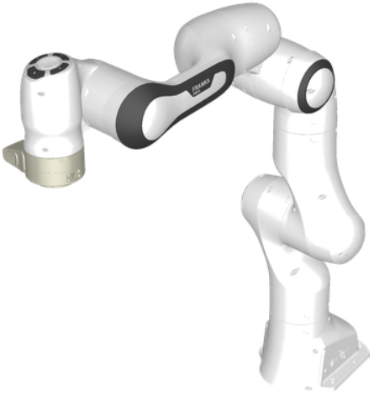
Introduction
Objective:
Apply Bayesian Optimization to tune the trajectory tracking control parameters of a 7-DOFs robotic arm, optimising PID gains and joint masses to minimise tracking error.
Main task: Parameters tuning for each joint ($K_{p}, K_{i}, K_{d}$)
Additional tasks:
Virtual masses tuning
Sequential optimization from last joint to first joint
Off-set evaluation
Perturbation of the dynamics
The following work outlines the project workflow, presents the various solutions explored under different considerations, and highlights the most promising one.
Franka Emika Panda Robot

Slide 4

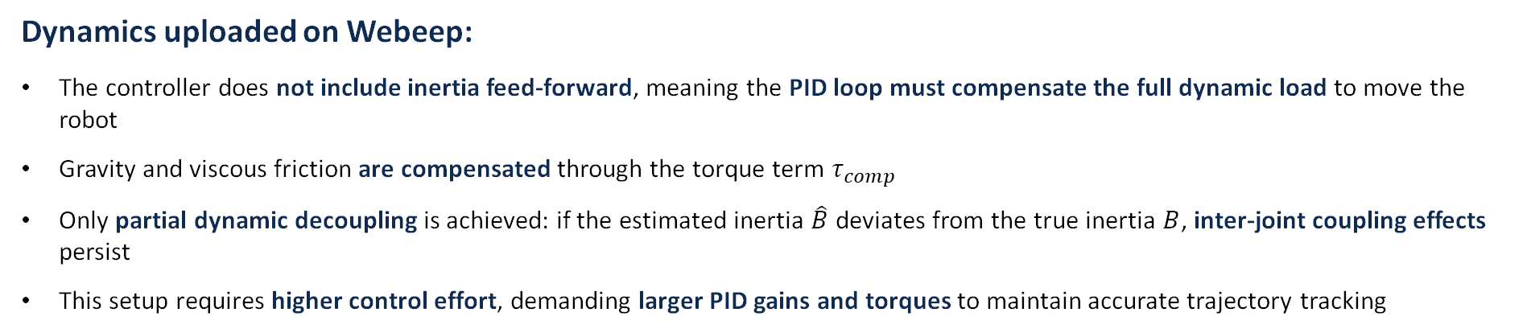
Dynamics
The control system is tested under two dynamic formulations:
Dynamics uploaded on Webeep:
The controller does not include inertia feed-forward, meaning the PID loop must compensate the full dynamic load to move the robot
Gravity and viscous friction are compensated through the torque term $τ_{comp}$
Only partial dynamic decoupling is achieved: if the estimated inertia $\hat{B}$ deviates from the true inertia $B$, inter-joint coupling effects persist
This setup requires higher control effort, demanding larger PID gains and torques to maintain accurate trajectory tracking
,

Slide 5

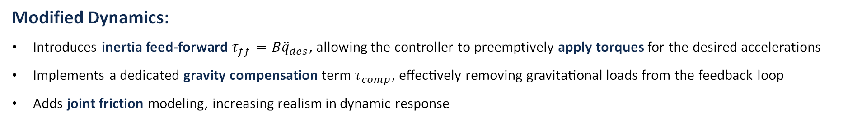
Dynamics
The control system is tested under two dynamic formulations:
Modified Dynamics:
Introduces inertia feed-forward $τ_{ff}=B{\ddot{q}}_{des}$, allowing the controller to preemptively apply torques for the desired accelerations
Implements a dedicated gravity compensation term $τ_{comp}$​, effectively removing gravitational loads from the feedback loop
Adds joint friction modeling, increasing realism in dynamic response
,
,

Slide 6
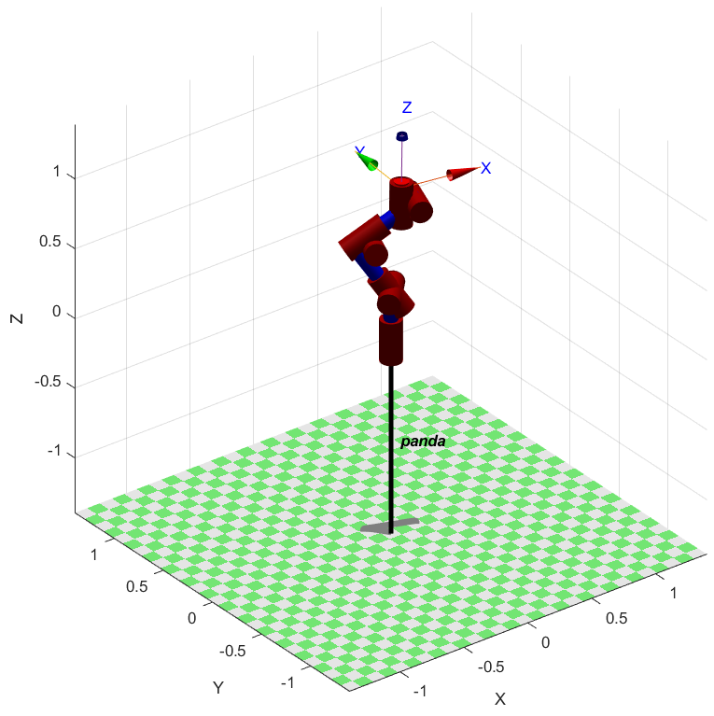

Bayesian Optimization settings
Define robot model and compute reference trajectory
Create optimization variables: $K_{p}, K_{i}, K_{d}$for each DoF.
Set parameter bounds for each optimization variables.
Define the objective function J
Configure bayesopt on matlab:
Acquisition function: 'expected-improvement'
Deterministic objective
Parallel evaluation enabled
Initial seed points: 30
Active set size: 500
Optimization step
Simulation & results analysis

Slide 7
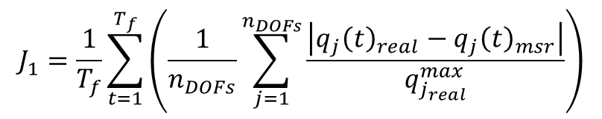

Cost Function
The cost function used for the Bayesian Optimization problem is composed by 4 components:
$$J=J_{1}+J_{2}+J_{3}+J_{4}$$
$J_{1}$ : Mean Position Error
$$J_{1}=\frac{1}{T_{f}}\sum_{t=1}^{T_{f}}{\left(\frac{1}{n_{DOFs}}\sum_{j=1}^{n_{DOFs}}{\frac{\left|q_{j}{\left(t\right)}_{real}−q_{j}{\left(t\right)}_{msr}\right|}{q_{j_{real}}^{max}}}\right)}$$
where t is the time, $T_{f}$ is the final time, $n_{DOFs}$ is the number of Degrees of freedom of the mechanical system, $q_{real}$ is the real position trajectory of the robot, while $q_{msr}$ is the measured position trajectory.
Quantifies the average position tracking error across all joints and time steps.
Normalizes the error by the maximum joint displacement to ensure scale invariance.
Promotes accurate and consistent trajectory tracking across all degrees of freedom.

Slide 8
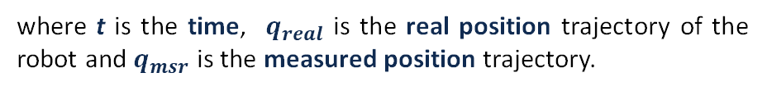
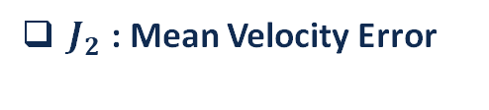
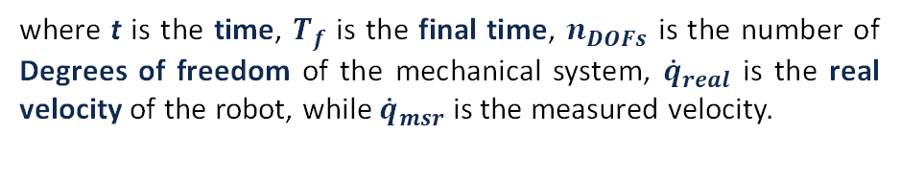

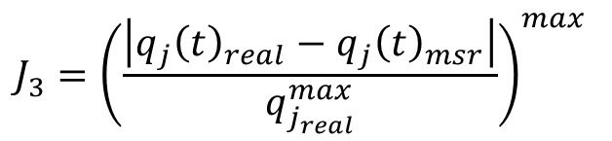
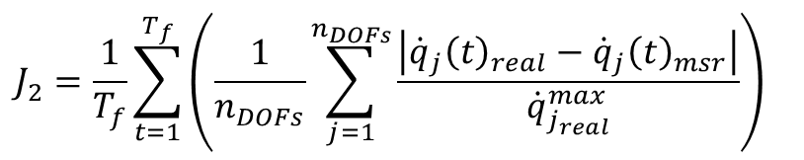
Cost Function
$J_{2}$ : Mean Velocity Error
$J_{3}$ : Maximum Position Error
$$J_{2}=\frac{1}{T_{f}}\sum_{t=1}^{T_{f}}{\left(\frac{1}{n_{DOFs}}\sum_{j=1}^{n_{DOFs}}{\frac{\left|{\dot{q}}_{j}{\left(t\right)}_{real}−{\dot{q}}_{j}{\left(t\right)}_{msr}\right|}{{\dot{q}}_{j_{real}}^{max}}}\right)}$$
$$J_{3}={\left(\frac{\left|q_{j}{\left(t\right)}_{real}−q_{j}{\left(t\right)}_{msr}\right|}{q_{j_{real}}^{max}}\right)}^{max}$$
where t is the time, $T_{f}$ is the final time, $n_{DOFs}$ is the number of Degrees of freedom of the mechanical system, ${\dot{q}}_{real}$ is the real velocity of the robot, while ${\dot{q}}_{msr}$ is the measured velocity.
where t is the time, $q_{real}$ is the real position trajectory of the robot and $q_{msr}$ is the measured position trajectory.
Captures the worst-case position error among all joints over the entire time horizon.
Uses normalized error to account for differences in joint scales.
Penalizes large deviations to ensure reliability in critical moments of the trajectory.
An instability watchdog halts execution upon error divergence to ensure safety
Computes the average velocity tracking error across all joints and time steps.
Normalizes the error using the maximum joint velocity to ensure comparability.
Excludes the initial transient (e.g., first 0.5 s) to focus on steady-state tracking performance.

Slide 9
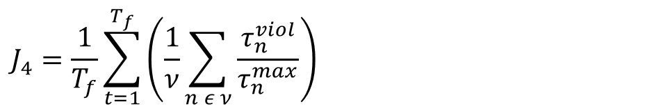

Cost Function
$J_{4}$ : Torque Limitation
$$J_{4}=\frac{1}{T_{f}}\sum_{t=1}^{T_{f}}{\left(\frac{1}{ν}\sum_{n ε ν}{\frac{τ_{n}^{viol}}{τ_{n}^{max}}}\right)}$$
$$ν=\left\{i ε n_{DOFs} | τ_{i}^{viol}>0\right\}, τ_{i}^{viol}=τ_{i}^{viol,+}+τ_{i}^{viol,−}, \left\{\begin{aligned}τ_{i}^{viol,+}=max⁡(τ_{i}^{PID}−τ_{i}^{max},0) \\ τ_{i}^{viol,−}=max⁡(τ_{i}^{min}−τ_{i}^{PID},0)\end{aligned}\right.$$
where t is the time, $T_{f}$ is the final time, $n_{DOFs}$ is the number of Degrees of freedom of the mechanical system, τ is the torque of the joint and ν is the number of violations.
Evaluates whether the torques generated by the PID controller exceed the admissible joint limits specified in the Panda robot datasheet, for every joint and time step..
Penalizes both upper and lower bound violations by summing the magnitudes of torque values that lie outside the allowed range.
Encourages feasible and safe control behaviour, ensuring that the optimized controller respects the physical constraints of the actuators.

Slide 10
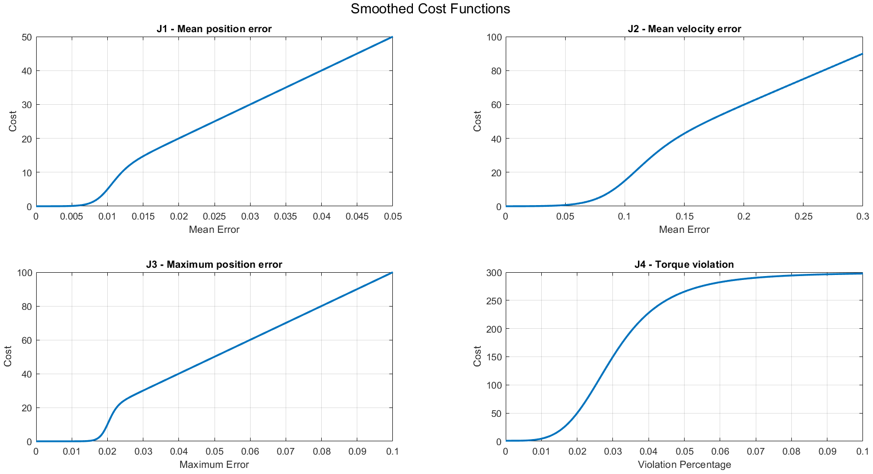
Cost Function
Nonlinear cost functions selectively penalize performance violations
Each cost term increases gradually beyond a defined threshold, ensuring small errors have limited impact while larger deviations are penalized more severely
The torque violation cost exhibits the steepest slope, emphasizing actuator constraints without requiring additional manual weighting
The cost function evaluates the performance by dynamically changing the weights of each component:
$J=w_{1}\left(e_{q, mean}\right) J_{mean, pos}+w_{2}\left(e_{\dot{q},mean}\right){ J}_{mean,vel}+w_{3}(e_{q, max}) J_{peak ,pos}+$ $w_{4}(τ) J_{torque}$

Slide 11
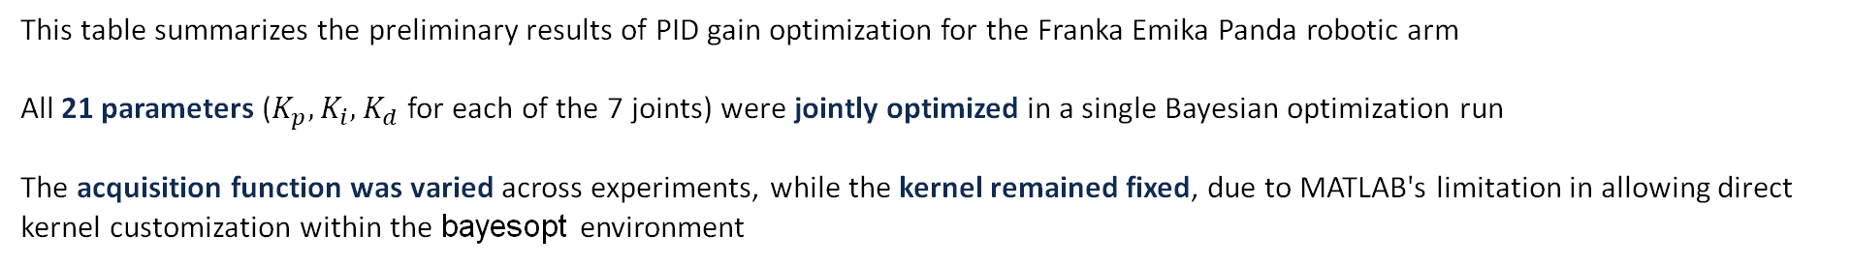
Acquisition Function Comparison
Evaluation of Bayesian Optimization Acquisition Functions
Number of evaluation | Aquisition function | Best objective | Best objective at iteration
700 | ‘expected_improvemnt_plus’ | 74.677 | 582
700 | ‘expecxted_improvement’ | 84.5222 | 277
700 | ‘lower_confidence_bound’ | 67.8735 | 109
700 | ‘expected_improvement_per_second’ | 55.7645 | 274
700 | ‘probability_of_improvement’ | 73.2984 | 589
This table summarizes the preliminary results of PID gain optimization for the Franka Emika Panda robotic arm
All 21 parameters ($K_{p}, K_{i}, K_{d}$ for each of the 7 joints) were jointly optimized in a single Bayesian optimization run
The acquisition function was varied across experiments, while the kernel remained fixed, due to MATLAB's limitation in allowing direct kernel customization within the bayesopt environment

Slide 12
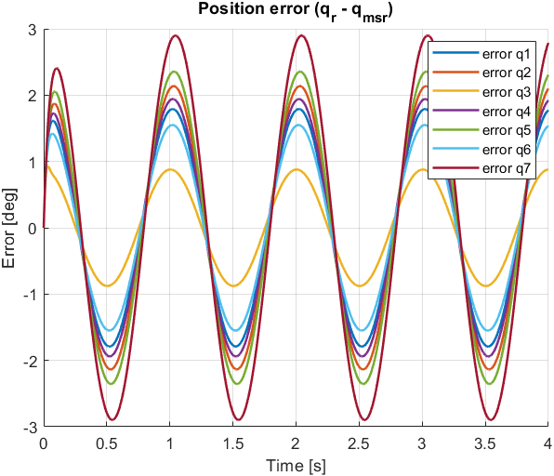
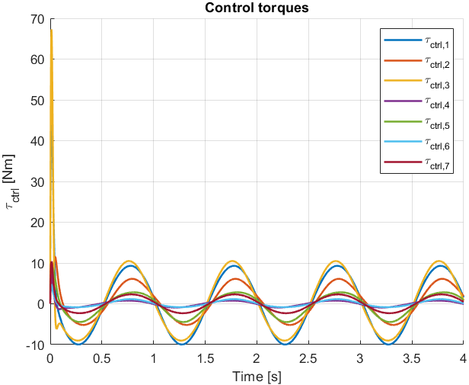
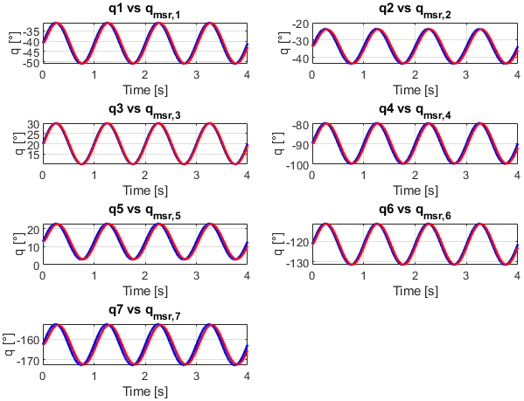
Solution 1: 21 Parameters Optimization
Validation results for the best acquisition function setting:
Best acquisition function: expected_improvement_per_second
With the best-performing acquisition function, the optimized controller achieved satisfactory performance, maintaining joint position errors below 3° throughout the entire simulation
The torque profiles exhibit an initial peak due to the controller’s response to non-zero initial velocities, but quickly stabilize as the system converges toward the desired trajectory

Slide 13
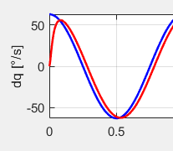
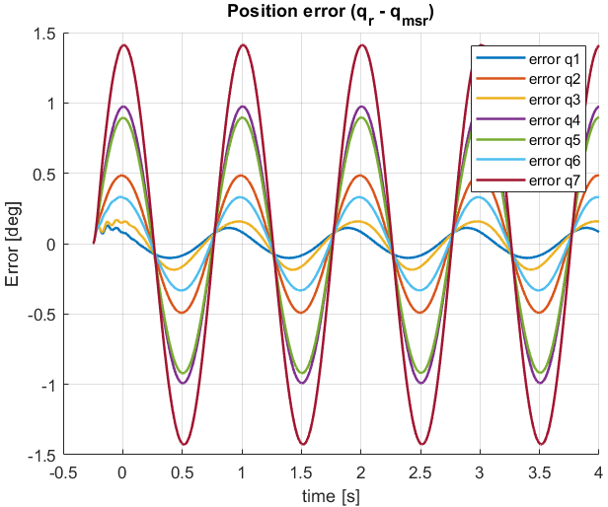
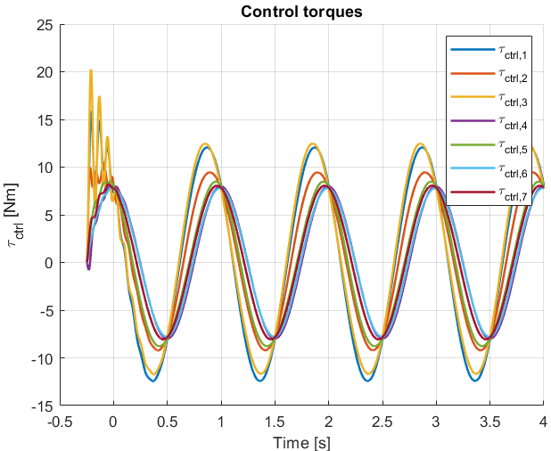
Solution 2: Off-set
Optimization setup: 21 PID gains + (-0.25 s) Off-set
Reference motion started with maximum speed, requiring aggressive control effort
Robot starts from rest → large torque spikes to catch up with fast-moving reference
Smoother initialization → better control efficiency, no compromise on accuracy
Despite using the same dynamics and optimization setup, introducing the time offset significantly improved results: Max position error dropped from ~3° to <1.5°, and peak torque reduced from ~70 Nm to ~20 Nm
Best Objective at iteration: 426

Slide 14
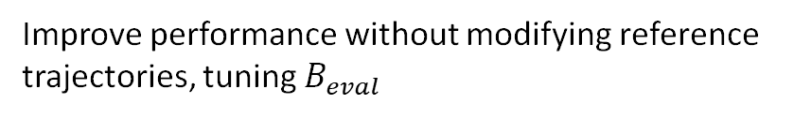
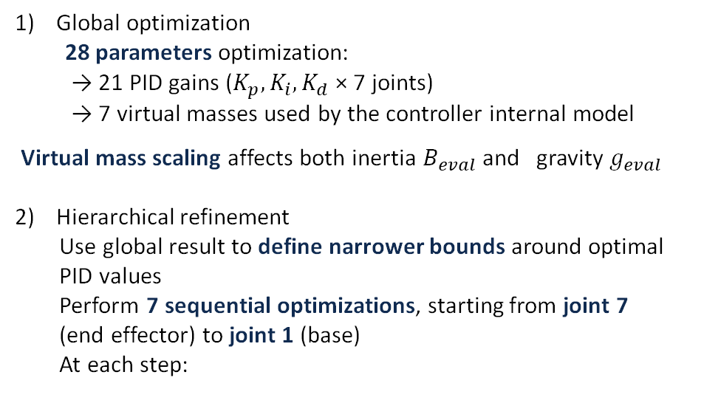
Solution 3.1: Cascade Optimization
Goal:
Improve performance without modifying reference trajectories, tuning $B_{eval}$
28 parameters optimization
Number of evaluations | 600
Mass bound | 0-5 kg
Best Objective | 54.6648
Best Objective at iter | 98
Steps:
Global optimization
28 parameters optimization:
→ 21 PID gains ($K_{p}, K_{i}, K_{d}$× 7 joints)
→ 7 virtual masses used by the controller internal model
Virtual mass scaling affects both inertia $B_{eval}$and gravity $g_{eval}$
Hierarchical refinement
Use global result to define narrower bounds around optimal
PID values
Perform 7 sequential optimizations, starting from joint 7
(end effector) to joint 1 (base)
At each step:
Sequence of 7 optimizations | k = 1 … 7
Number of evaluations | 50 + k ∙50
Bound of current joint (PID) | ± 2000
Bound for Dowstrean joint (PID) | ± 200
Bound of current joint (mass) | ± 2 kg
Bound for Dowstrean joint (mass) | ± 0.2 kg
Best Objective | 35.5186
Best Objective of opt. 7 at iter | 128
Refine parameters for the current joint
Fix or constrain downstream joints based on updated values
Propagate updated values upstream

Slide 15
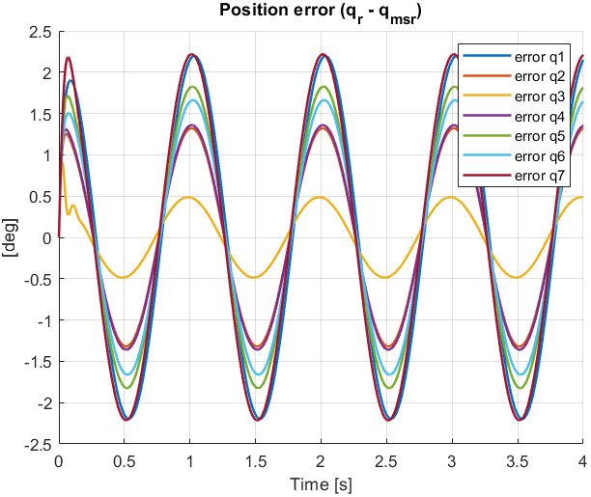
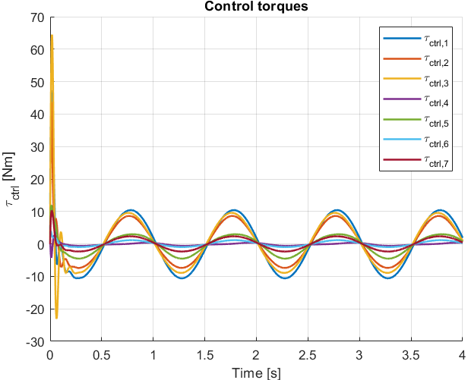
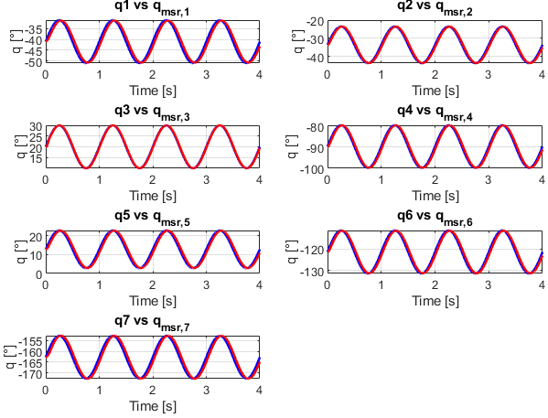
Solution 3.1: Cascade Optimization
Results: Cascade Optimization
This approach outperforms the 21-PID baseline, but remains inferior to the time-offset strategy, with ~2° max position error and torque peaks near 65 Nm
Despite improved optimization structure, the initial mismatch between reference and actual state dominates performance degradation

Slide 16
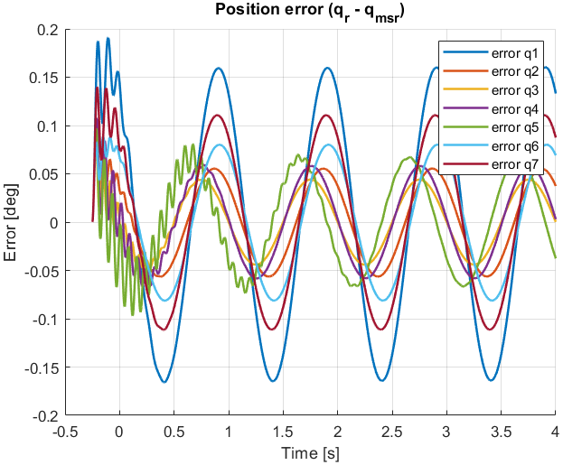
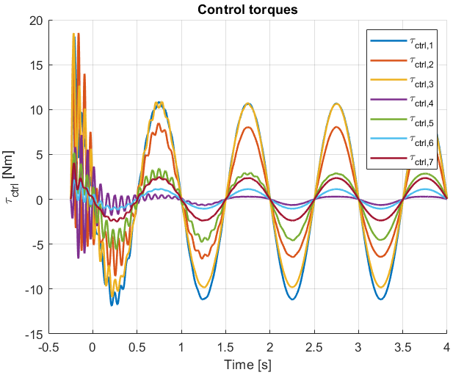
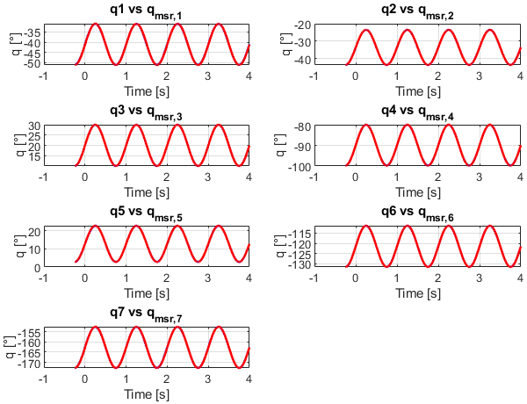
Solution 3.2: Cascade Optimization– Off-set
Results: Cascade Optimization with Off-set
Combining the 28-parameter optimization (PID + virtual masses) with a time-offset on the reference trajectories significantly improves both tracking accuracy and torque efficiency
The maximum position error drops to <0.2° on joint 1, and the peak torque is reduced to ~18 Nm. The only notable effect is a slight torque wobble at the beginning, likely caused by controller sensitivity during low-speed phases
Best Objective for Global Preliminary Optimization at iteration: 45 Best Objective for Sequential Optimization at iteration: 94

Slide 17
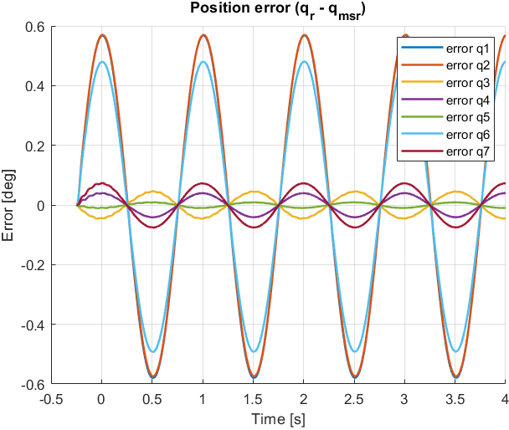
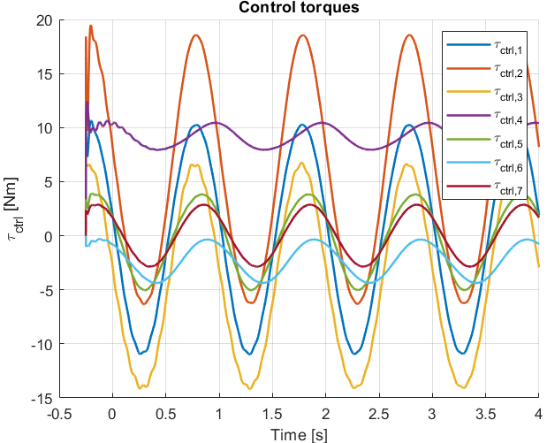
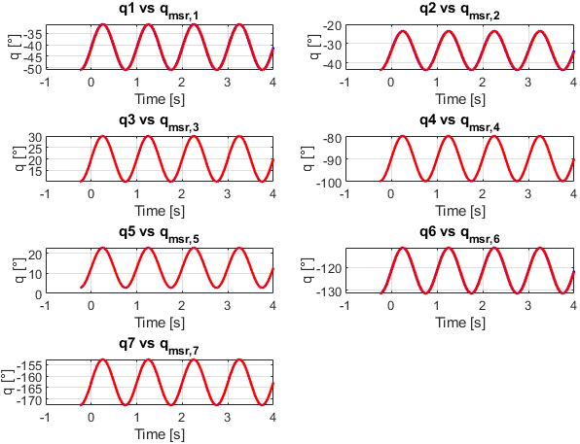
Solution 4: Real Dynamics
Dynamic Model: Modified dynamics
Introduction of inertia feed-forward $τ_{ff}$and friction
Optimization strategy: Initial 28-parameter optimization + 7 sequential joint-level refinements
More realistic evaluation of the control strategy
Main goal: Evaluate the robustness and generalization of the optimized controller under realistic, time-varying dynamics
Result: ~0.6° max error, ~20 Nm peak torque
Best Objective for Global Preliminary Optimization at iteration: 255 Best Objective for Sequential Optimization at iteration: 237

Slide 18
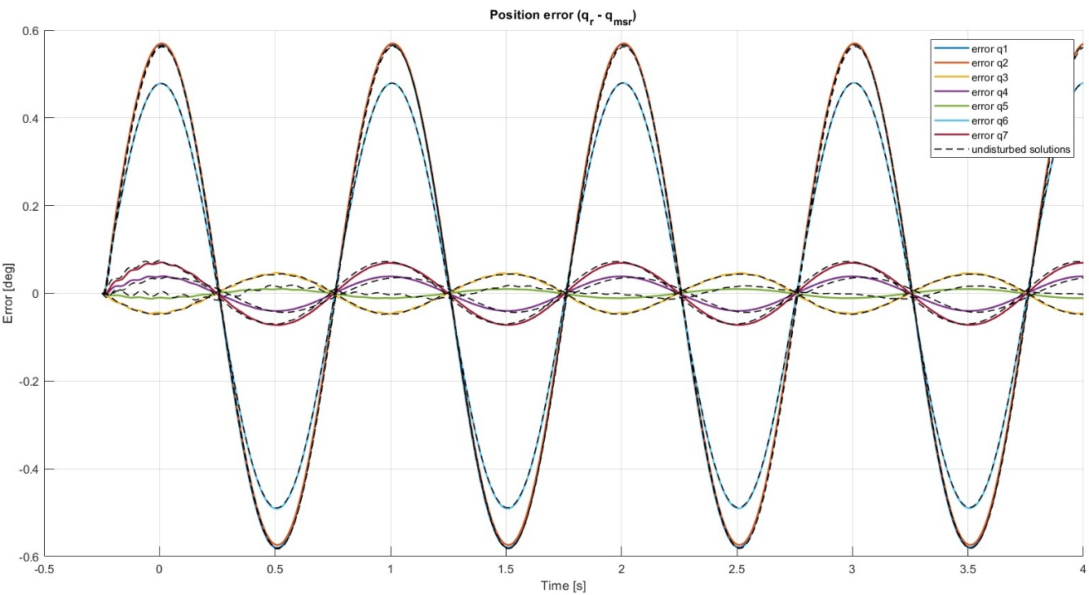
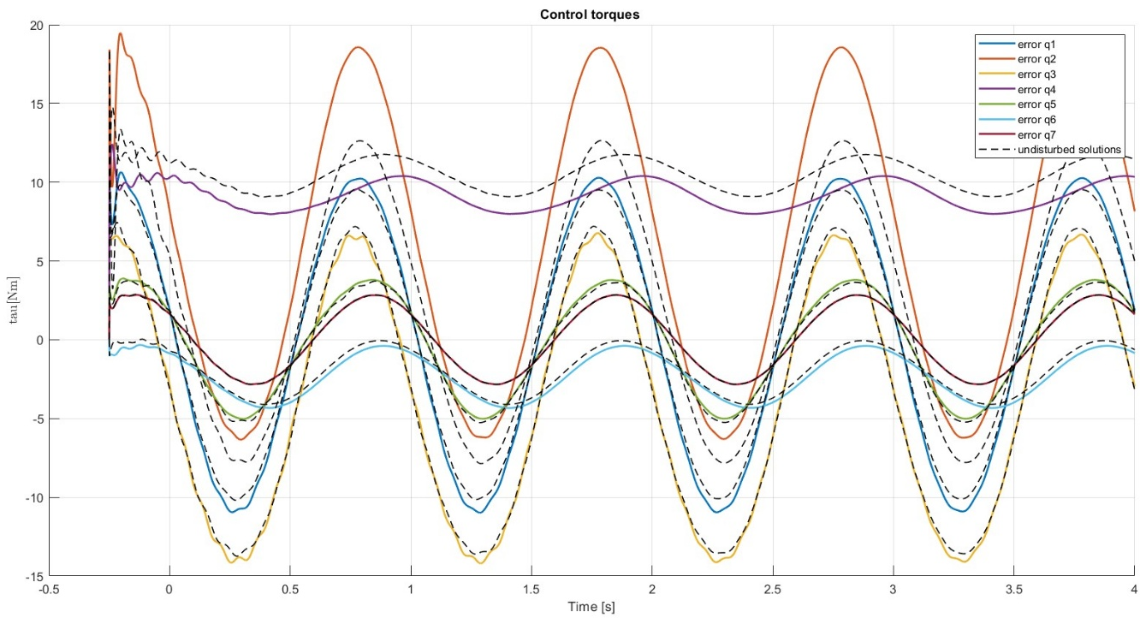
Perturbation Analysis
Dynamic Model: Modified dynamics
Solution considered: Initial 28-parameter optimization + 7 sequential joint-level refinements
Maximum uncertainty on all joints viscous coefficient: ± 50%
The perturbation has minimal impact on performance, confirming the controller’s robustness to moderate friction estimation errors

Slide 19

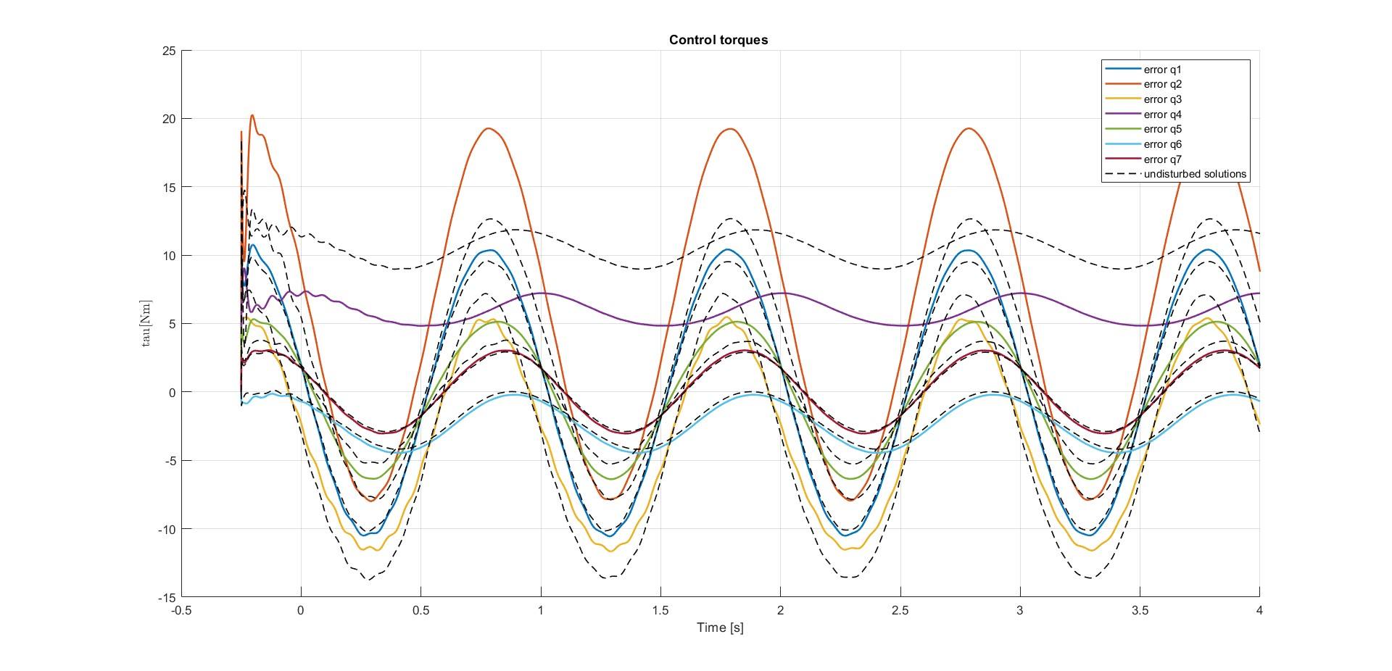
Perturbation Analysis
Dynamic Model: Modified dynamics
Solution considered: Initial 28-parameter optimization + 7 sequential joint-level refinements
Initial joint position perturbation: ± 20%
The tracking performance remained unchanged, confirming the robustness of the control strategy to initial condition variations

Slide 20
Machine Learning for Mechanical Systems Professor: Loris Roveda
Thanks for your attention
09.06.2025 | Bellini, Biraghi, Boccia

